Slide 1


Customized Multi-Person Tracker
Liqian Ma¹ Qianru Sun^{2*} Stamatios Georgoulis¹ Luc Van Gool^{1,3} Bernt Schiele² Mario Fritz² ¹KU Leuven ²MPI for Informatics ³ETH Zürich *Corresponding author
Liqian Ma^{1*}
Siyu Tang^{2,3*}
Michael J. Black²
Luc Van Gool^{1,4}
¹KU Leuven ²MPI for Intelligent Systems
³University of Tübingen ⁴ETH Zürich
Notes:
Hello. My name is Liqian from KULeuven. Our paper is “Customized Multi-Person Tracker”.
This is a joint work with MPI for intelligent systems, Univ. of Tubingen, and ETHZ.
And Siyu is the co-first author.

Slide 2
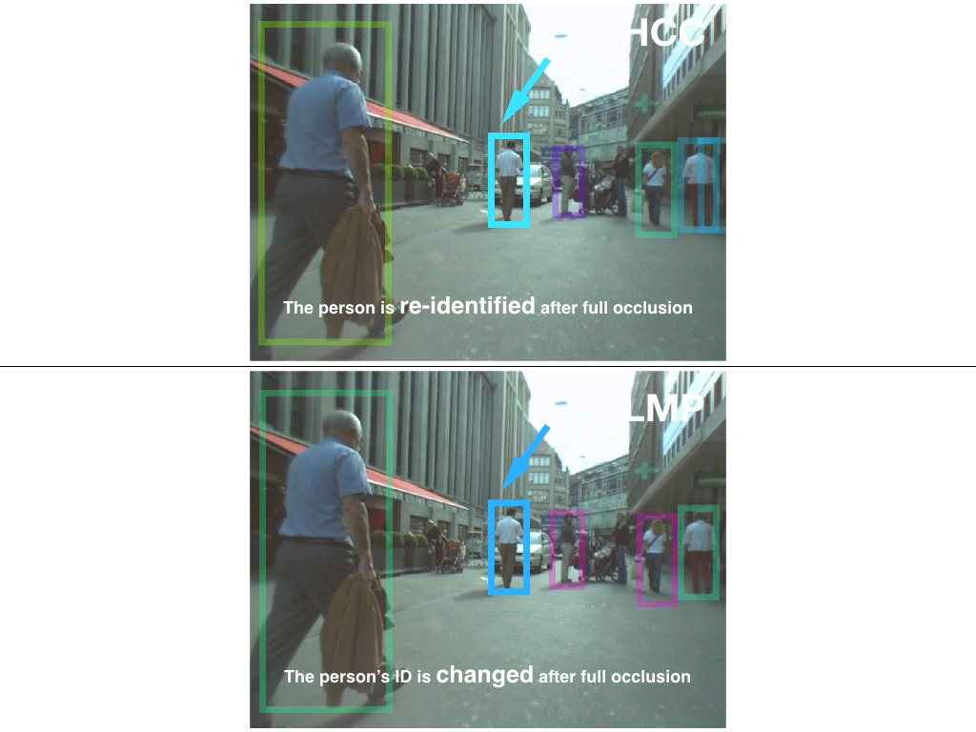
Problem statement
-- Customized Multi-Person Tracker
Motivation: To solve the long-term occlusion challenge in multi-person tracking problem with the person re-identification technique.
Task: Multi-person tracking in various crowded street scenes, where long-term occlusions pose a major challenge.
Key idea: Automatically adapt re-ID model to the target sequence in a hierarchical correlation clustering (HCC) framework.
Notes:
Our motivation is To solve the long-term occlusion challenge in multi-person tracking problem with the person re-identification technique which makes much success recently.
Our task is to track multiple persons in various crowded street scenes, where long-term occlusions pose a major challenge.
From the video, we can see the ID of the man in the blue bounding box changes 5 times within this 20 sec video. We can see the ID is usually changed after a long-term occlusion.
To address this challenge, we propose a method to automatically adapt the re-ID model to the target sequence in a Hierarchical correlation clustering framework.

Slide 3
Background
-- Customized Multi-Person Tracker
Correlation Clustering [1,2]
(a) Original graph (b) infeasible decomposition (c) feasible decomposition
[1] Gr¨otschel et al. A cutting plane algorithm for a clustering problem. Mathematical Programming’89.
[2] Bansal et al. Correlation Clustering. Machine Learning’04.
Notes:
I will first give a brief introduction about the correlation clustering.
xxx

Slide 4
Background
-- Customized Multi-Person Tracker
Correlation Clustering [1,2]
(a) Original graph (b) infeasible decomposition (c) feasible decomposition
Cycle constraints
For any cycles in the graph G, if one of its edges is labeled as a cut (x_{e} = 1), then there must be at least one more cut in the cycle.
[1] Gr¨otschel et al. A cutting plane algorithm for a clustering problem. Mathematical Programming’89.
[2] Bansal et al. Correlation Clustering. Machine Learning’04.
Notes:
To obtain the feasible decomposition, the cycle constraints is utilized

Slide 5
Background
-- Customized Multi-Person Tracker
Correlation Clustering [1,2]
(a) Original graph (b) infeasible decomposition (c) feasible decomposition
Cycle constraints
For any cycles in the graph G, if one of its edges is labeled as a cut (x_{e} = 1), then there must be at least one more cut in the cycle.
Objective
=
Given the features f ^{ee} of a training sequence, the model parameter θ is obtained by MLE.
,
=
[1] Gr¨otschel et al. A cutting plane algorithm for a clustering problem. Mathematical Programming’89.
[2] Bansal et al. Correlation Clustering. Machine Learning’04.
Notes:
The final objective to minimize the weighted summarization of the cut x_e,
The weight parameter c_e is ??

Slide 6
Framework
-- Customized Multi-Person Tracker
Hierarchical tracking framework
Local clustering
Re-ID Adaptation
Global clustering

Slide 7
Framework
-- Customized Multi-Person Tracker
Hierarchical tracking framework
Local clustering
Re-ID Adaptation
Global clustering
Local clustering. Decompose the detection graph into local tracklets using Correlation Clustering [1,2] with the similarity calculated by DeepMatching [3].
[3] Revaud et al. DeepMatching: Hierarchical deformable dense matching. IJCV’16

Slide 8
Framework
-- Customized Multi-Person Tracker
Hierarchical tracking framework
Local clustering
Re-ID Adaptation
Global clustering
The image pairs are fed into two weights sharing CNN branches followed by the matching part. Only verification part is finetuned during adaptation.
GoogLeNet[5] with ImageNet initialization is used as the CNN part.
Re-ID network of classification-verification architecture similar to [4].
[4] Sun et al. Deep learning face representation by joint identification-verification. NIPS’14.
[5] Szegedy et al. Going deeper with convolutions. CVPR’15.
Notes:
The google

Slide 9
Framework
-- Customized Multi-Person Tracker
Hierarchical tracking framework
Local clustering
Re-ID Adaptation
Global clustering
Training examples mined with physical constraints:
Positive pair, i.e. image pair in the same tracklet.
Negative pair, i.e. image pair overlapping temporally but not spatially.
Training examples mining
[4] Sun et al. Deep learning face representation by joint identification-verification. NIPS’14.

Slide 10
Framework
-- Customized Multi-Person Tracker
Hierarchical tracking framework
Local clustering
Re-ID Adaptation
Global clustering
Global clustering. Associate tracklets into global trajectories using Correlation Clustering with the similarity calculated by the adapted re-ID model.

Slide 11
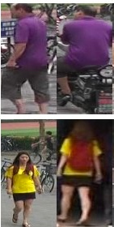
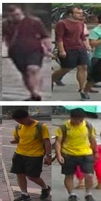
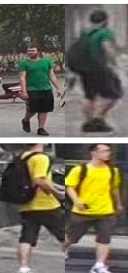

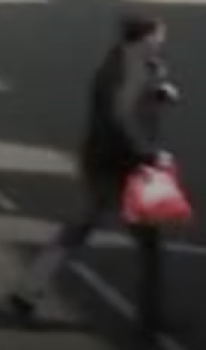
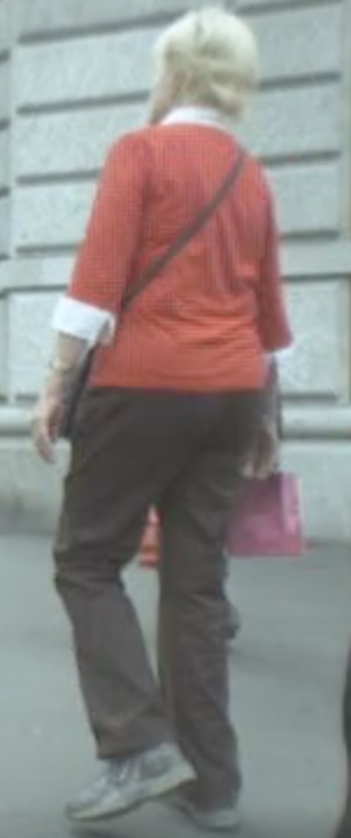
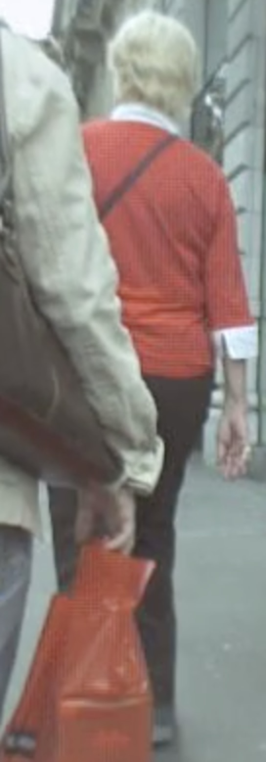

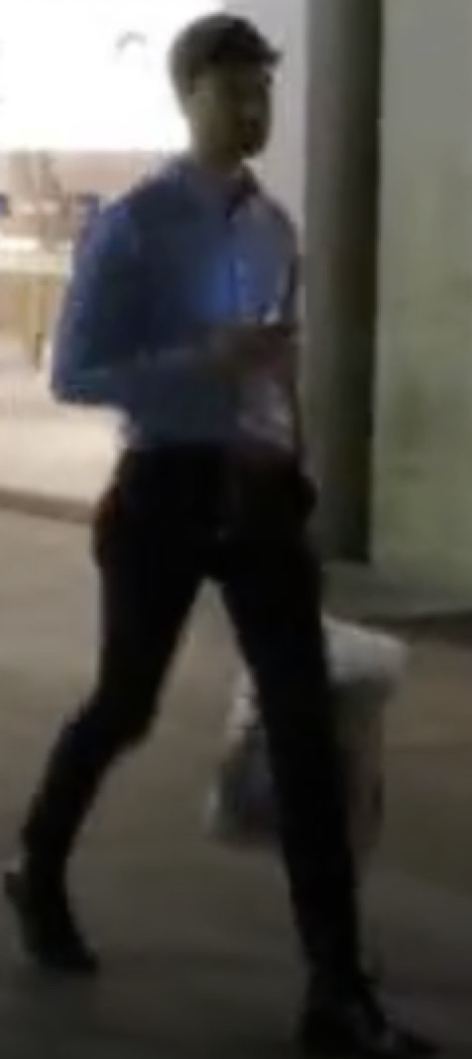
Experiments
-- Customized Multi-Person Tracker
Person re-ID accuracy
illumination
occlusion
moving blurry
Market-1501 pair samples
MOT16 pair samples from different scenes
MOT16 Re-ID accuracy
V-Net: re-ID verification sub-network only.
V+C-Net: re-ID verification-classification architecture.
Notes:
The images pairs in MOT scenes are very different from that in the standard re-ID dataset.
Besides, for different scenes, the samples also have very different characteristics, e.g. illumination variations, heavy occlusions, moving blurry.
Therefore, jointly train the re-ID network with the data from different MOT sequences can significantly improve the accuracy.
We use 80% data of … for training and the rest 20% for testing.
And the verification-classification architecture can also improve the accuracy a lot, especially when the training and testing scenes are very different. For example, training on Market data and testing on MOT data, the accuracy can be improved to 80.7 with the additional Classification subnet.

Slide 12
Experiments
-- Customized Multi-Person Tracker
Analysis on the adaptation approach
Generic: re-ID model trained offline w/o adaptation to test sequence.
Adaptation: re-ID model trained offline with adaptation to test sequence.
FC: only adapt final fully-connected layer.
E2E: adapt the whole re-ID model end-to-end.
* All models are initialized with ImageNet weights.
Notes:
End-to-end adaptation can significantly improve the re-id accuracy in multi-people tracking scenes

Slide 13
Experiments
-- Customized Multi-Person Tracker
Analysis on the adaptation approach
Generic: re-ID model trained offline w/o adaptation to test sequence.
Adaptation: re-ID model trained offline with adaptation to test sequence.
FC: only adapt final fully-connected layer.
E2E: adapt the whole re-ID model end-to-end.
* All models are initialized with ImageNet weights.
Notes:
In addition, without trained with re-id dataset, namely direct adapting the ImageNet pretrained model can also give a reasonable performance. It is comparable to the results of Generic Net pretrained with additional re-id dataset.
This phenomenon also shows the large domain gap between the standard re-id dataset and diverse tracking scenarios.

Slide 14
Experiments
-- Customized Multi-Person Tracker
Local clustering VS Global clustering
HCC ^{l}: only use local clustering with DeepMatching features.
HCC ^{g}_{generic}: use generic re-ID model trained offline without adaptation for global clustering based on local clustering.
HCC ^{g}_{adaptation}: use adapted re-ID model for global clustering based on local clustering.

Slide 15
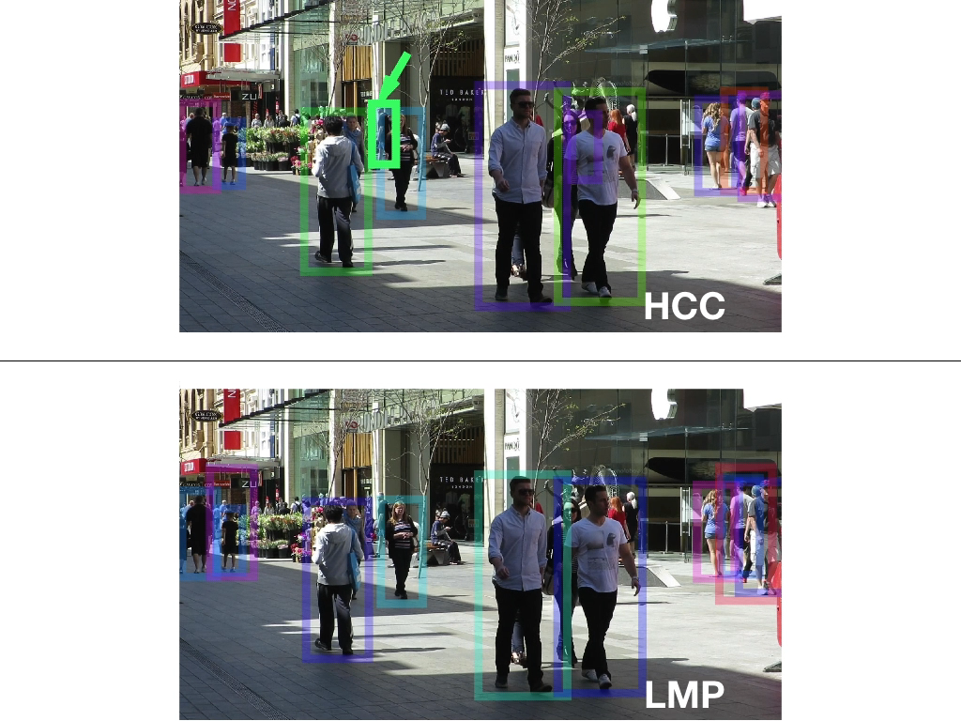
Experiments
-- Customized Multi-Person Tracker
Comparison on the MOT16 test set
Best in bold, second best in blue
Our method HCC
SOTA method LMP CVPR’17
Notes:
If you are interested in our work, please come to our poster. Thank you.

